Slide 1
ne_core_4wtiv_add_1_ahts
NE Core Scenario
Add 2 WTIV
Add 1 AHTS

Slide 2
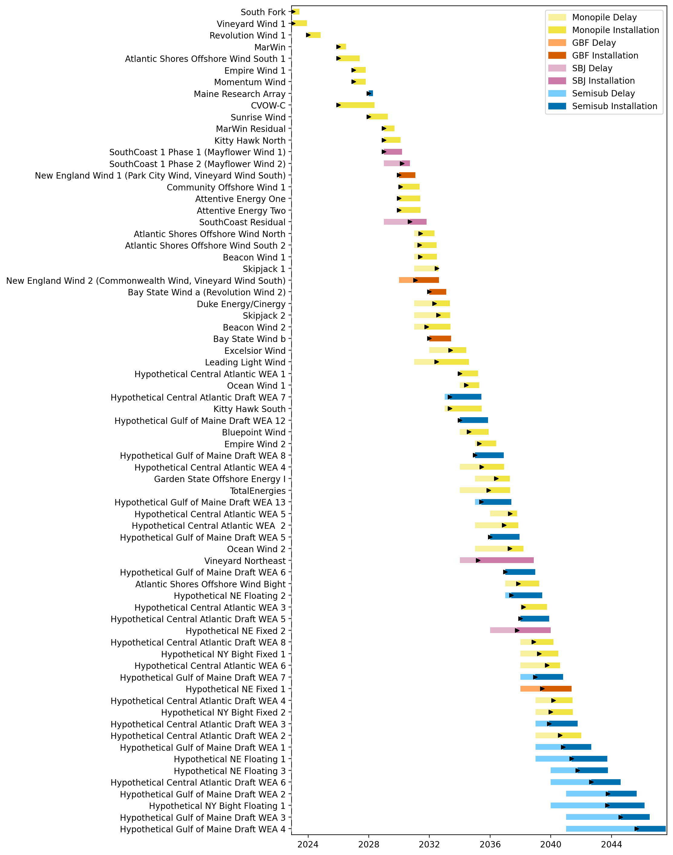
Full Gantt

Slide 3
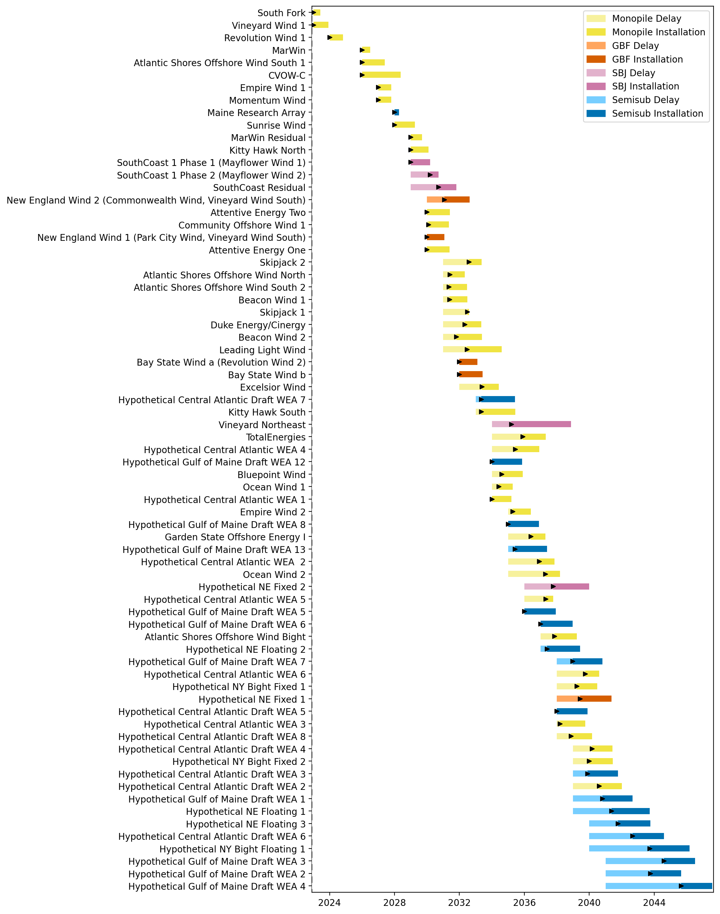
Sorted Full Gantt

Slide 4
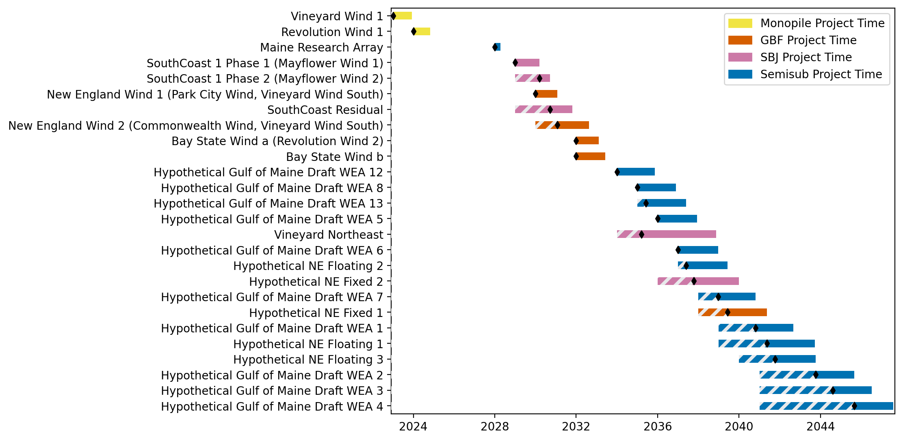
New England Gantt

Slide 5
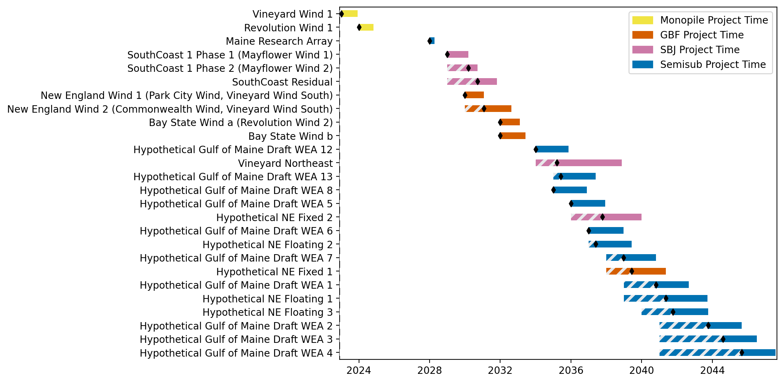
Sorted New England Gantt

Slide 6
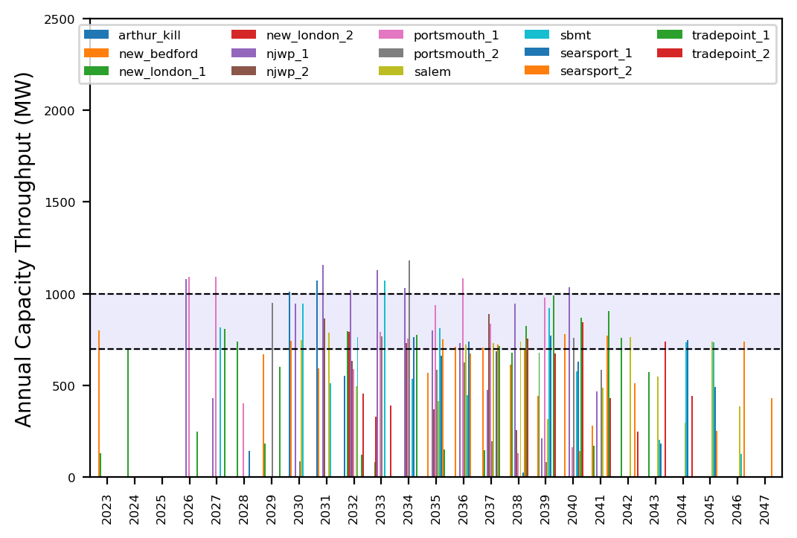
Port Throughput

Slide 7
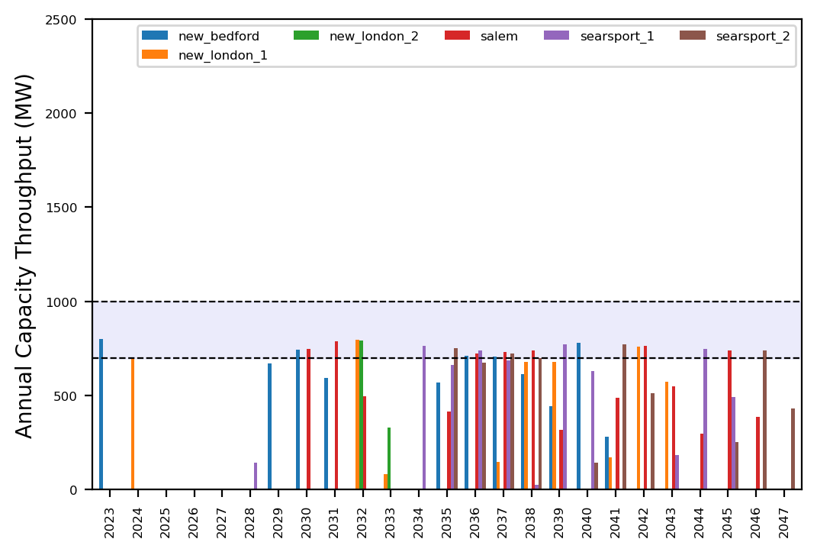
Port Throughput

Slide 8
ne_core_4wtiv_add_2_ahts
NE Core Scenario
Add 2 WTIV
Add 2 AHTS

Slide 9
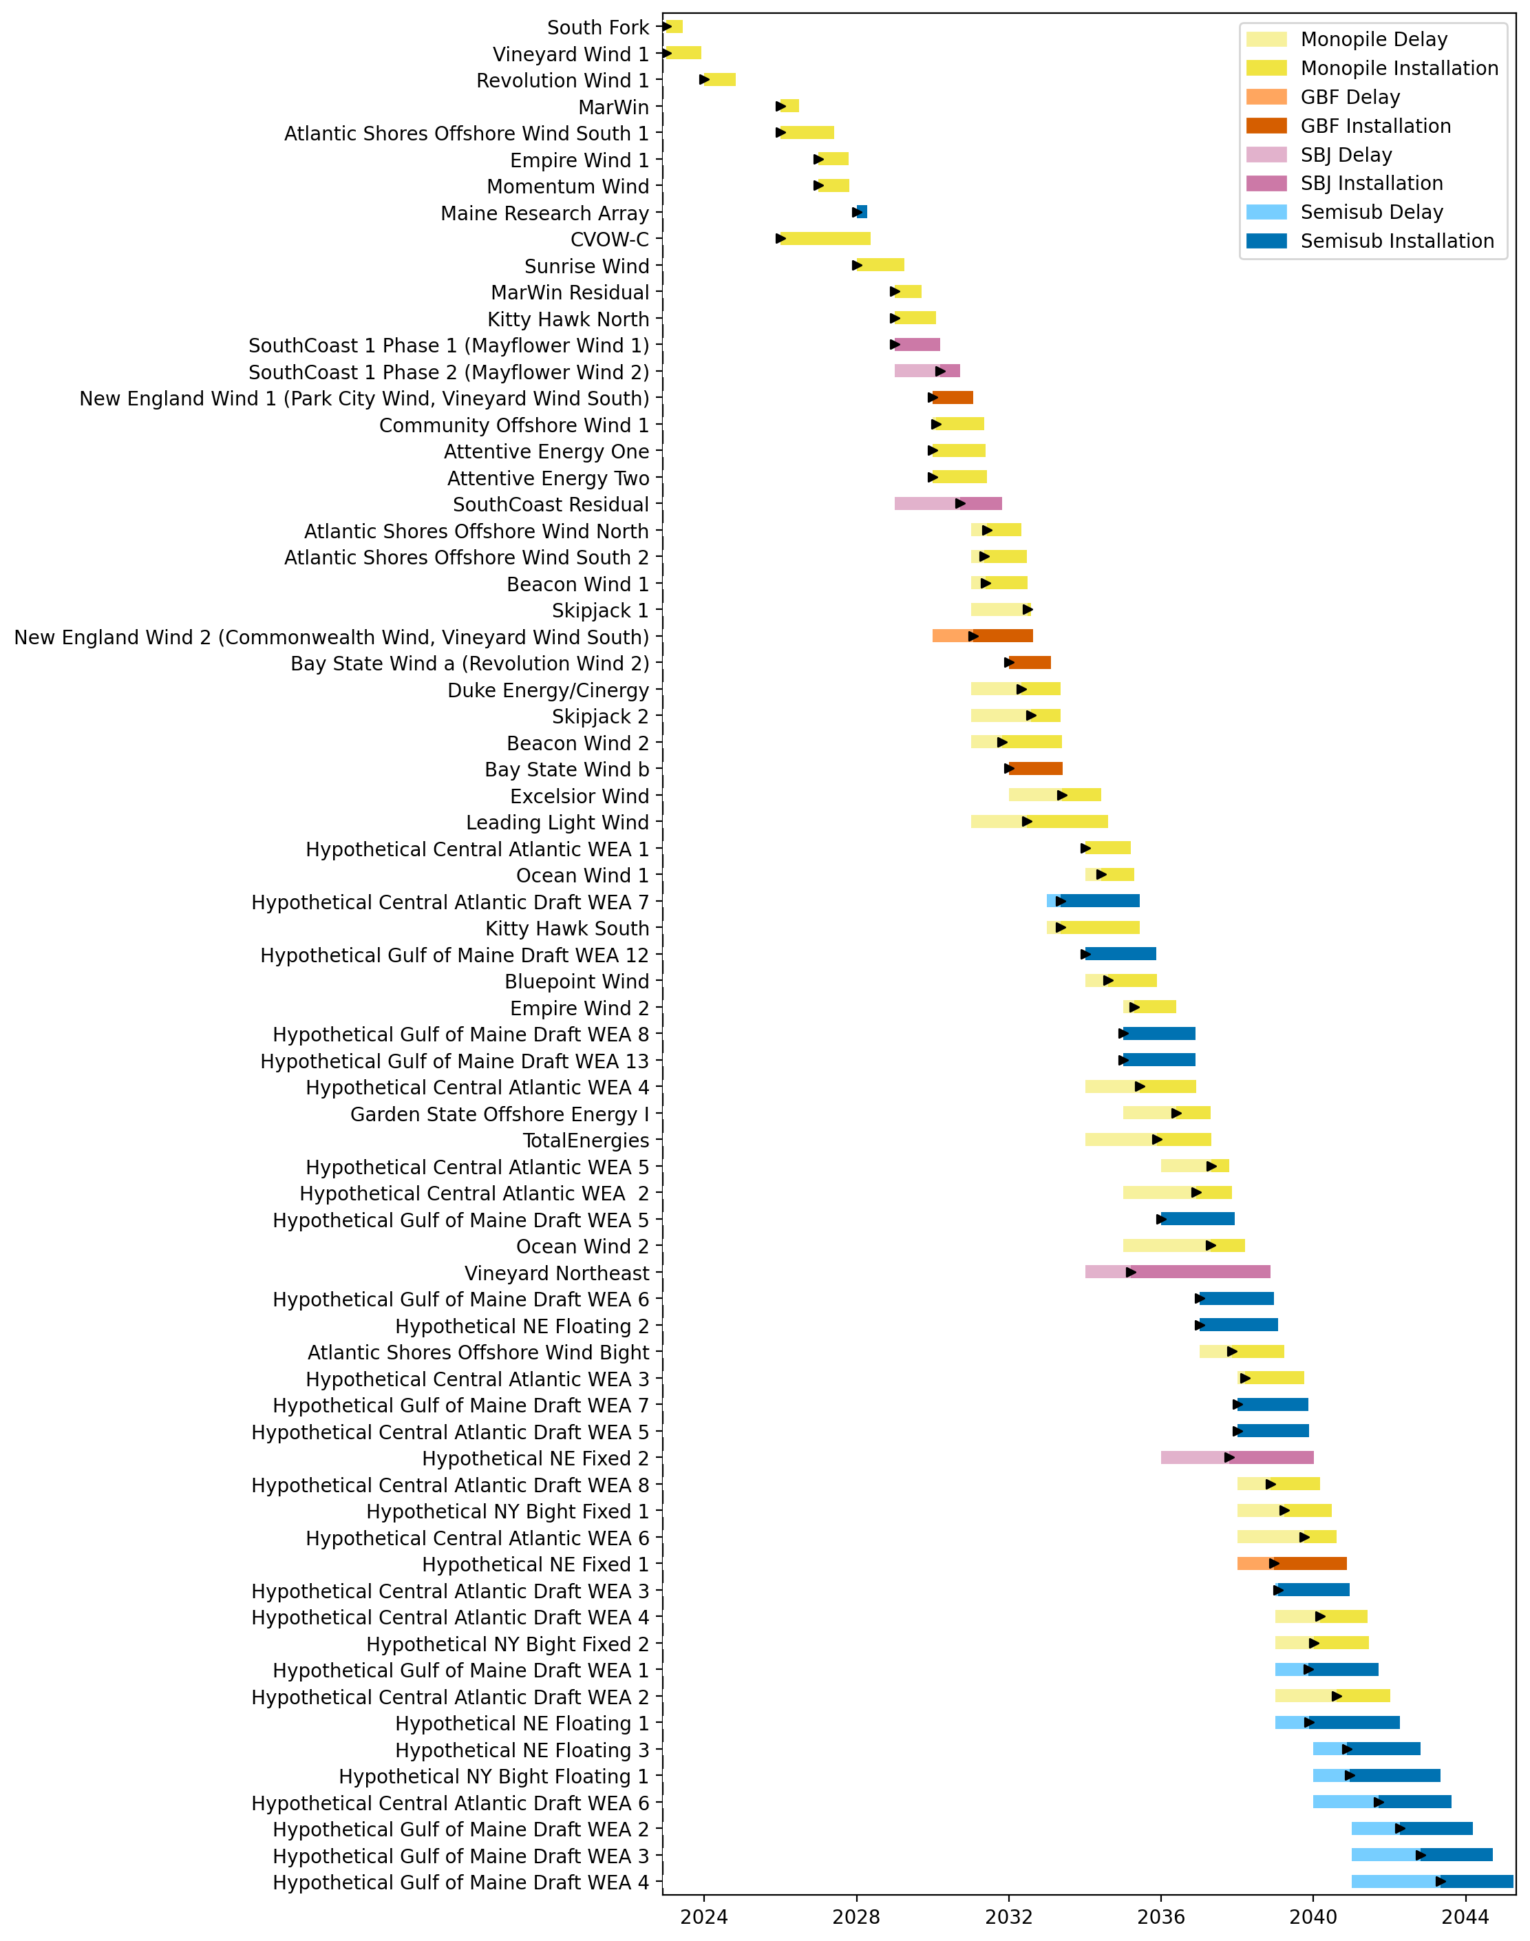
Full Gantt

Slide 10
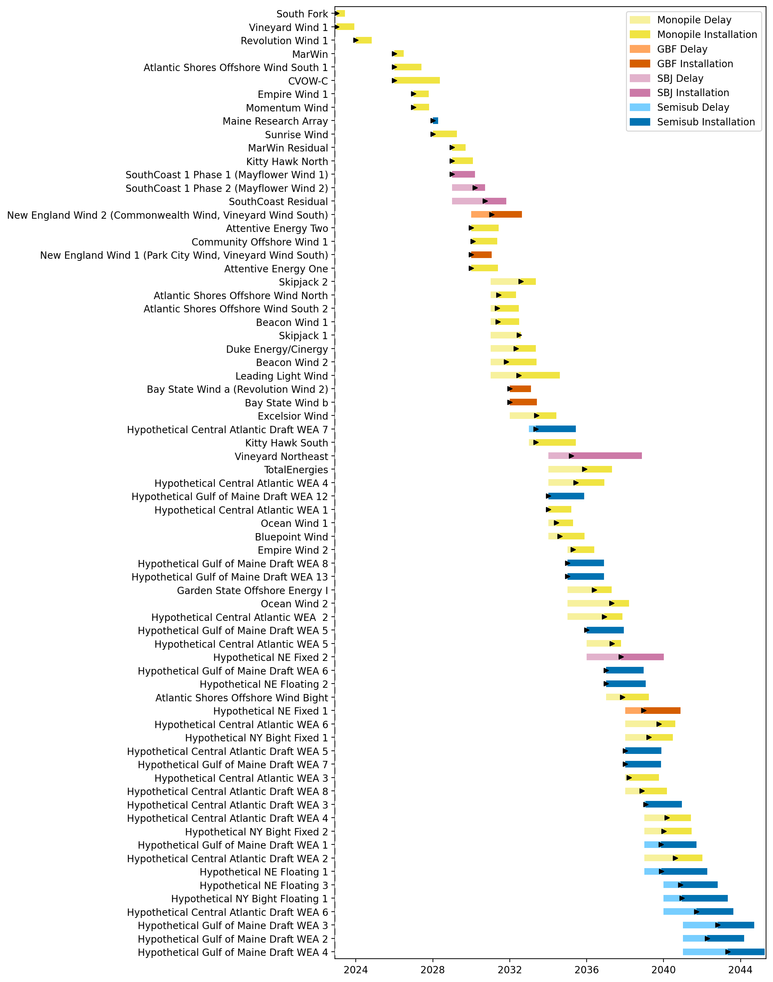
Sorted Full Gantt

Slide 11
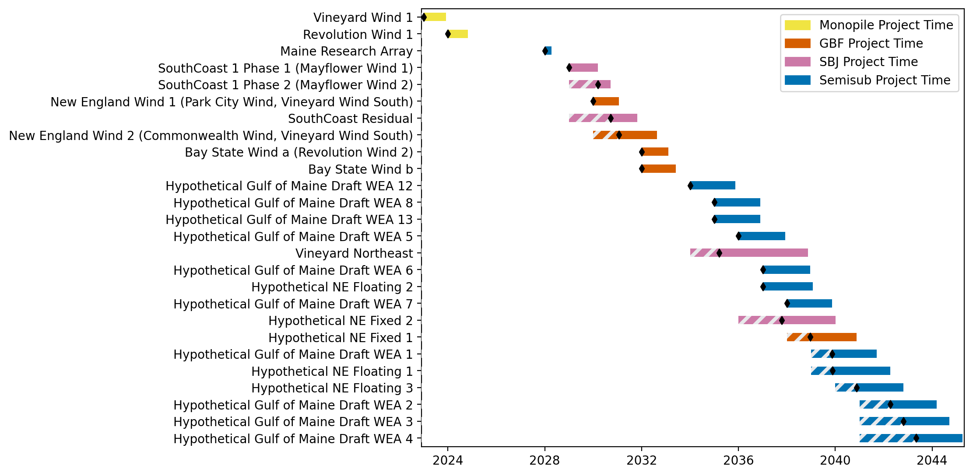
New England Gantt

Slide 12
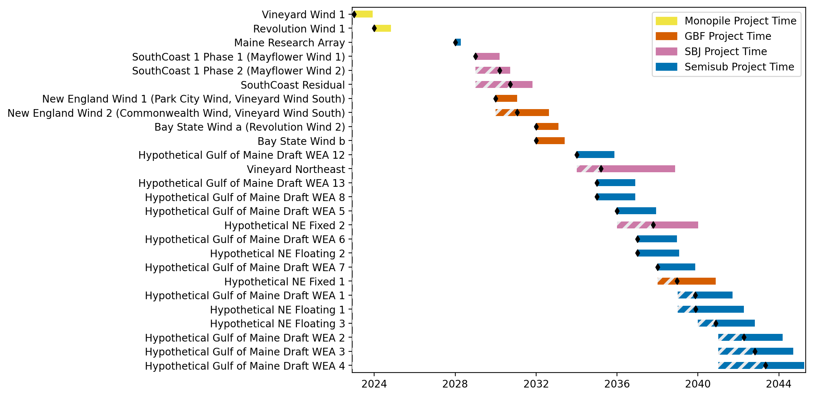
Sorted New England Gantt

Slide 13
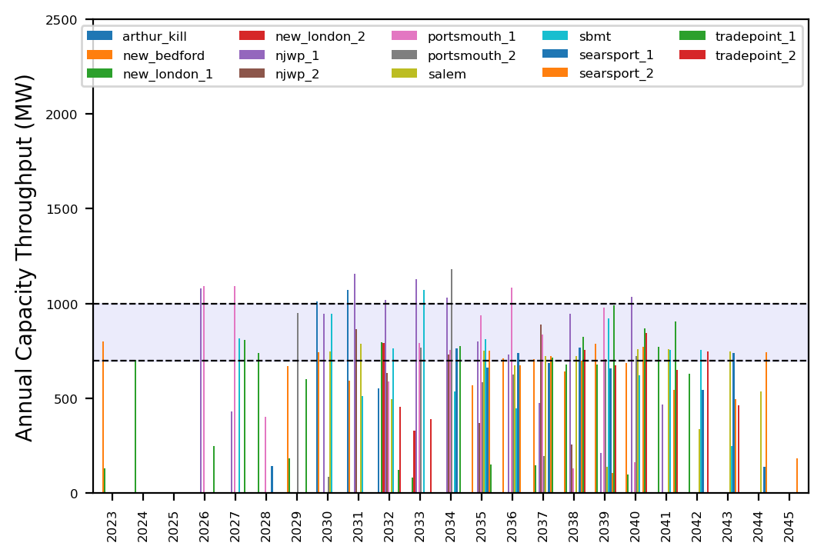
Port Throughput

Slide 14
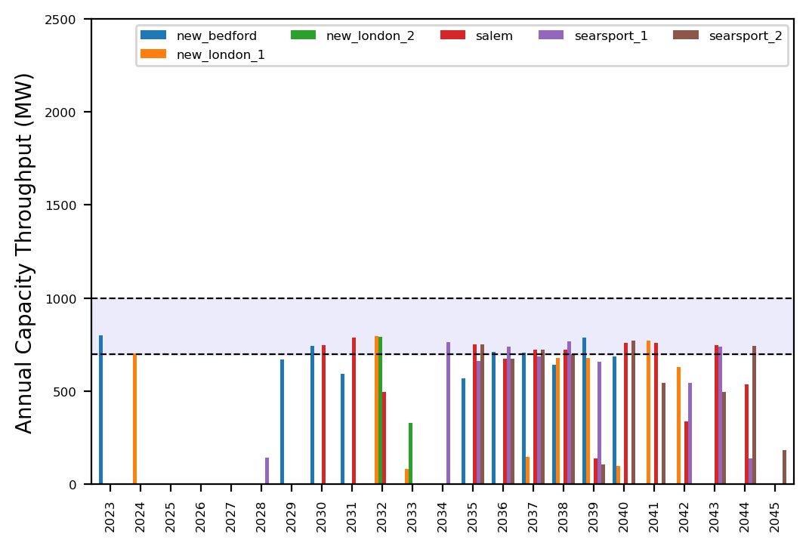
Port Throughput

Slide 15
ne_core_4wtiv_add_3_ahts
NE Core Scenario
Add 3 WTIV
Add 3 AHTS

Slide 16
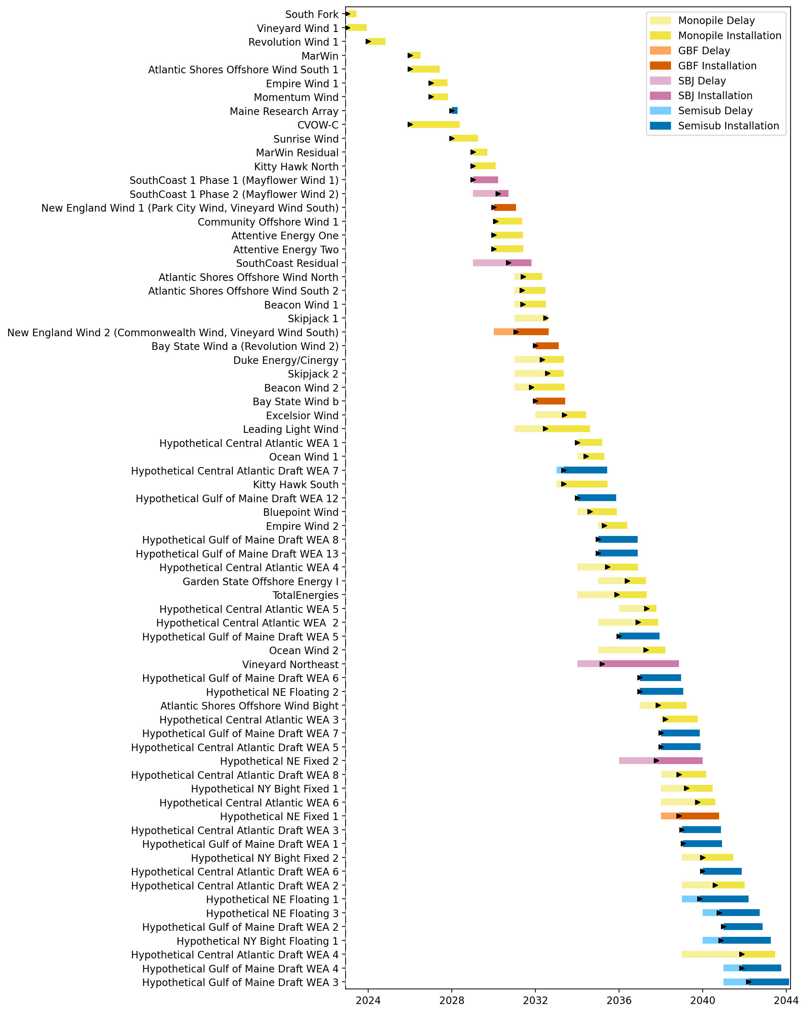
Full Gantt

Slide 17
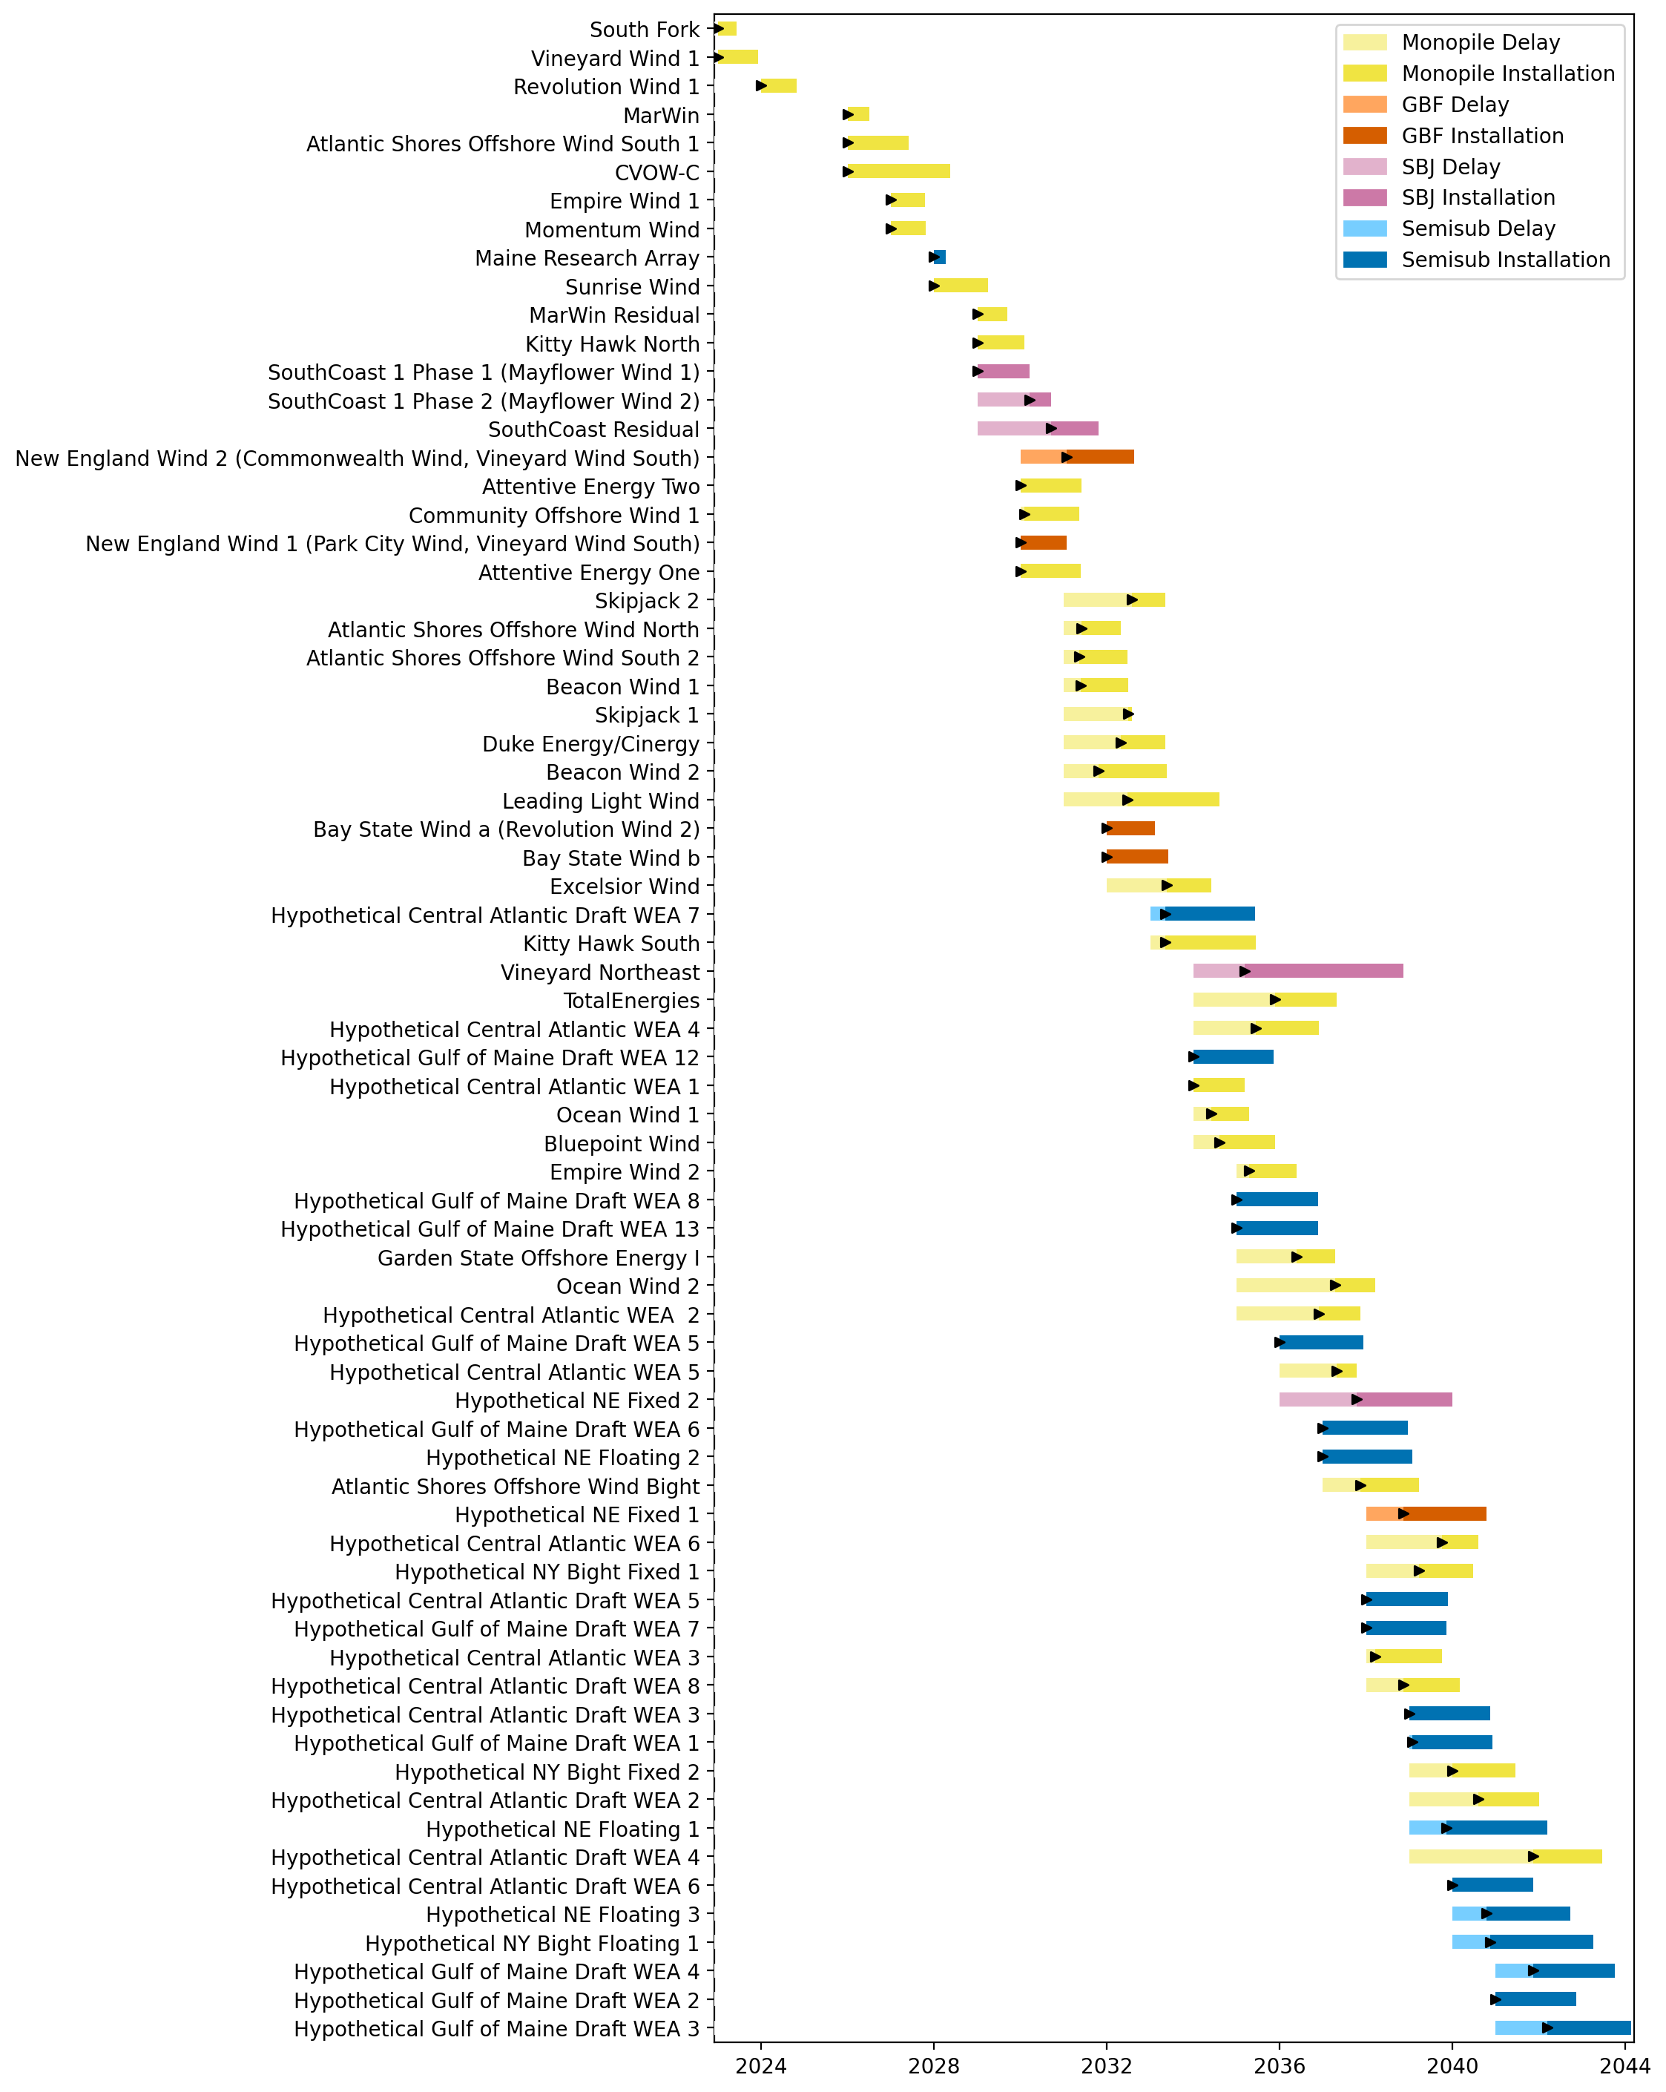
Sorted Full Gantt

Slide 18
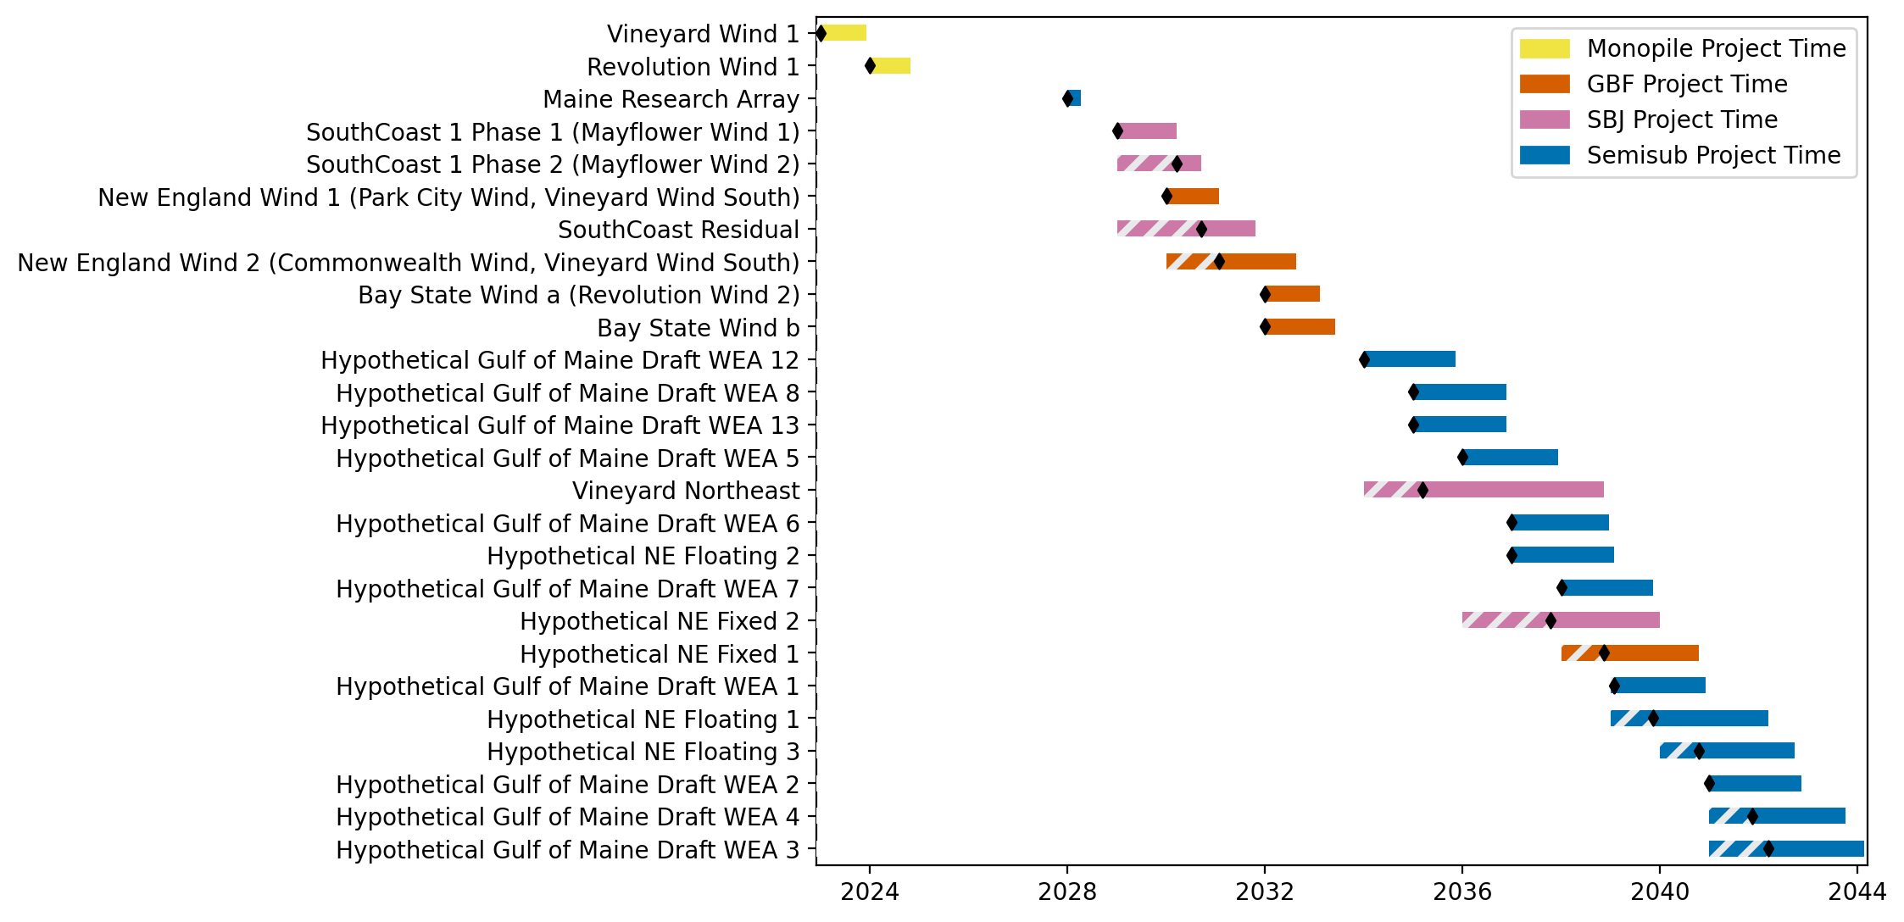
New England Gantt

Slide 19
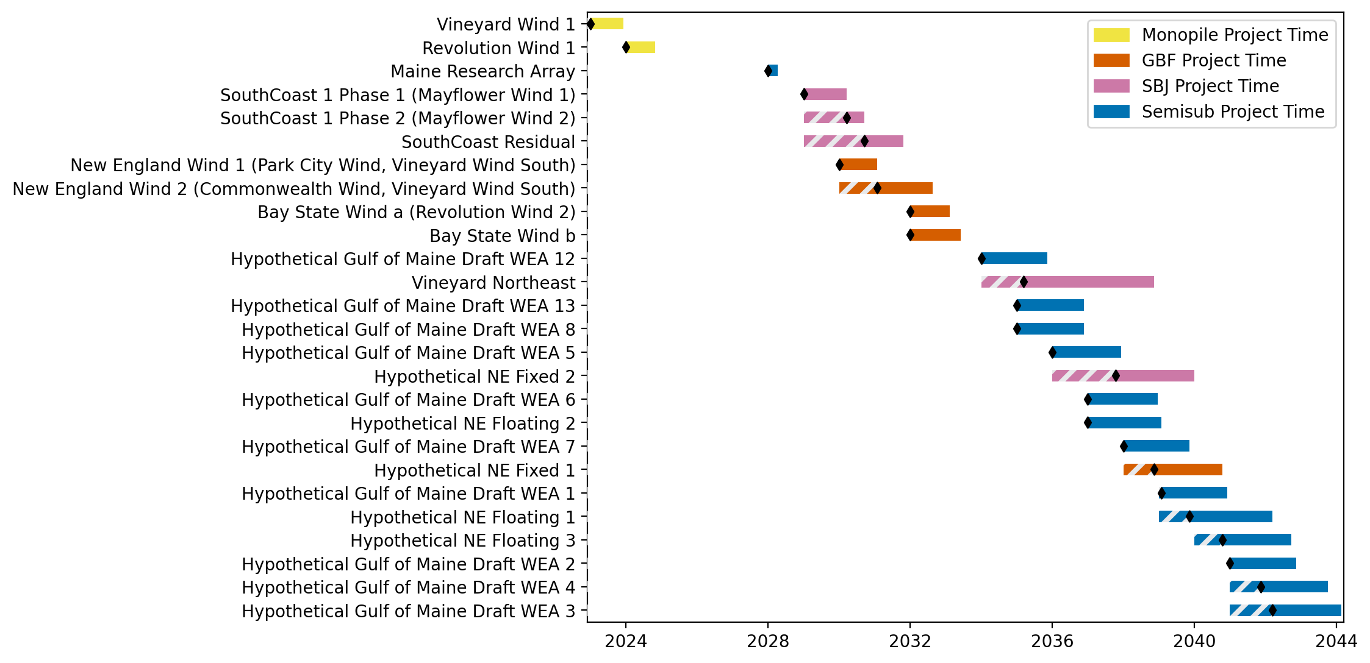
Sorted New England Gantt

Slide 20
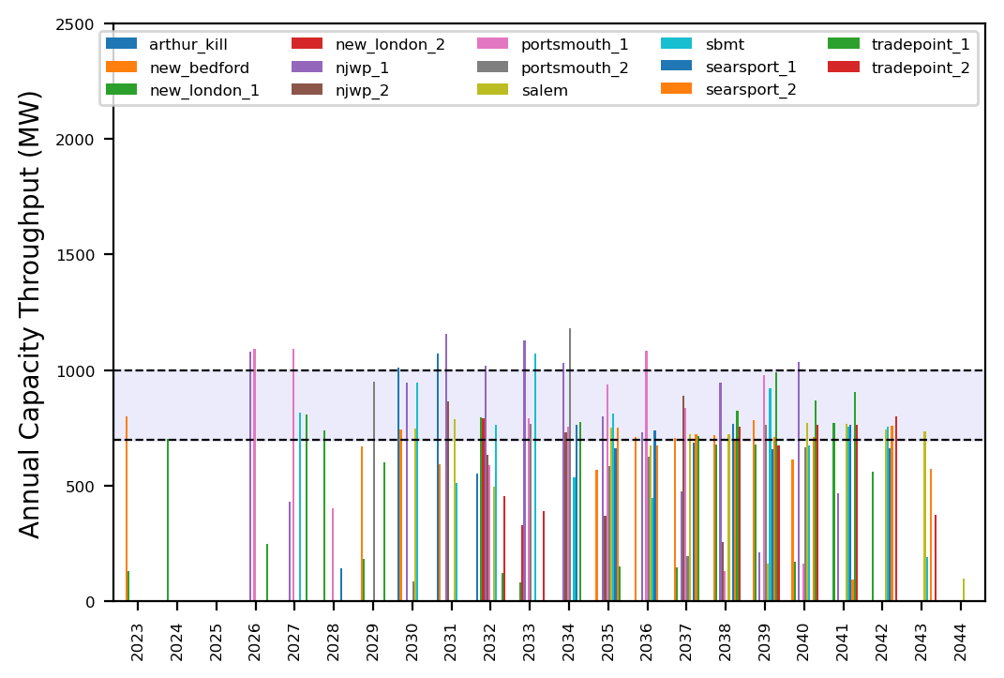
Port Throughput

Slide 21
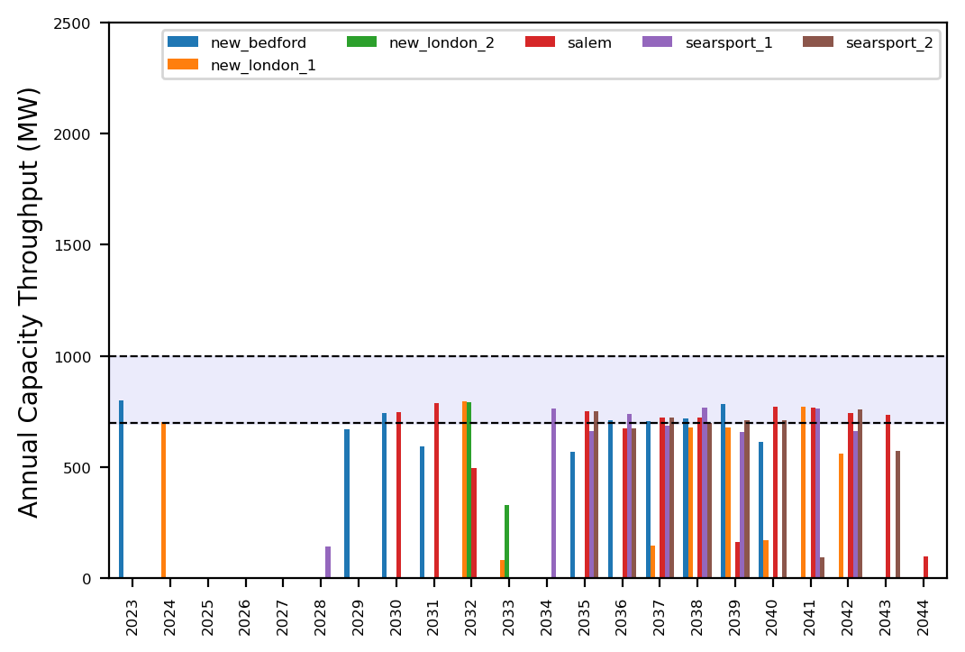
Port Throughput

Slide 22
ne_core_4wtiv_add_4_ahts
NE Core Scenario
Add 2 WTIV
Add 4 AHTS

Slide 23
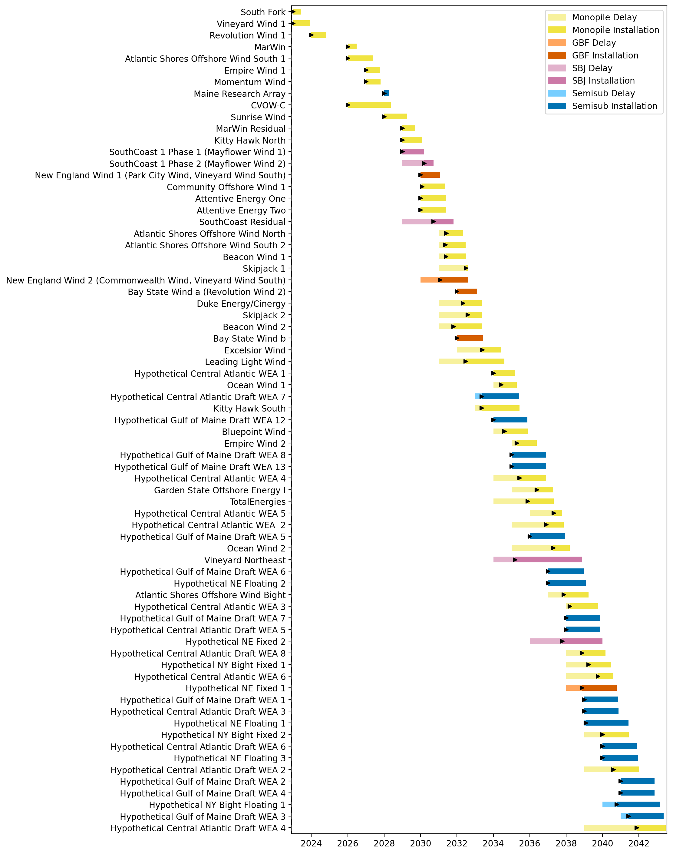
Full Gantt

Slide 24
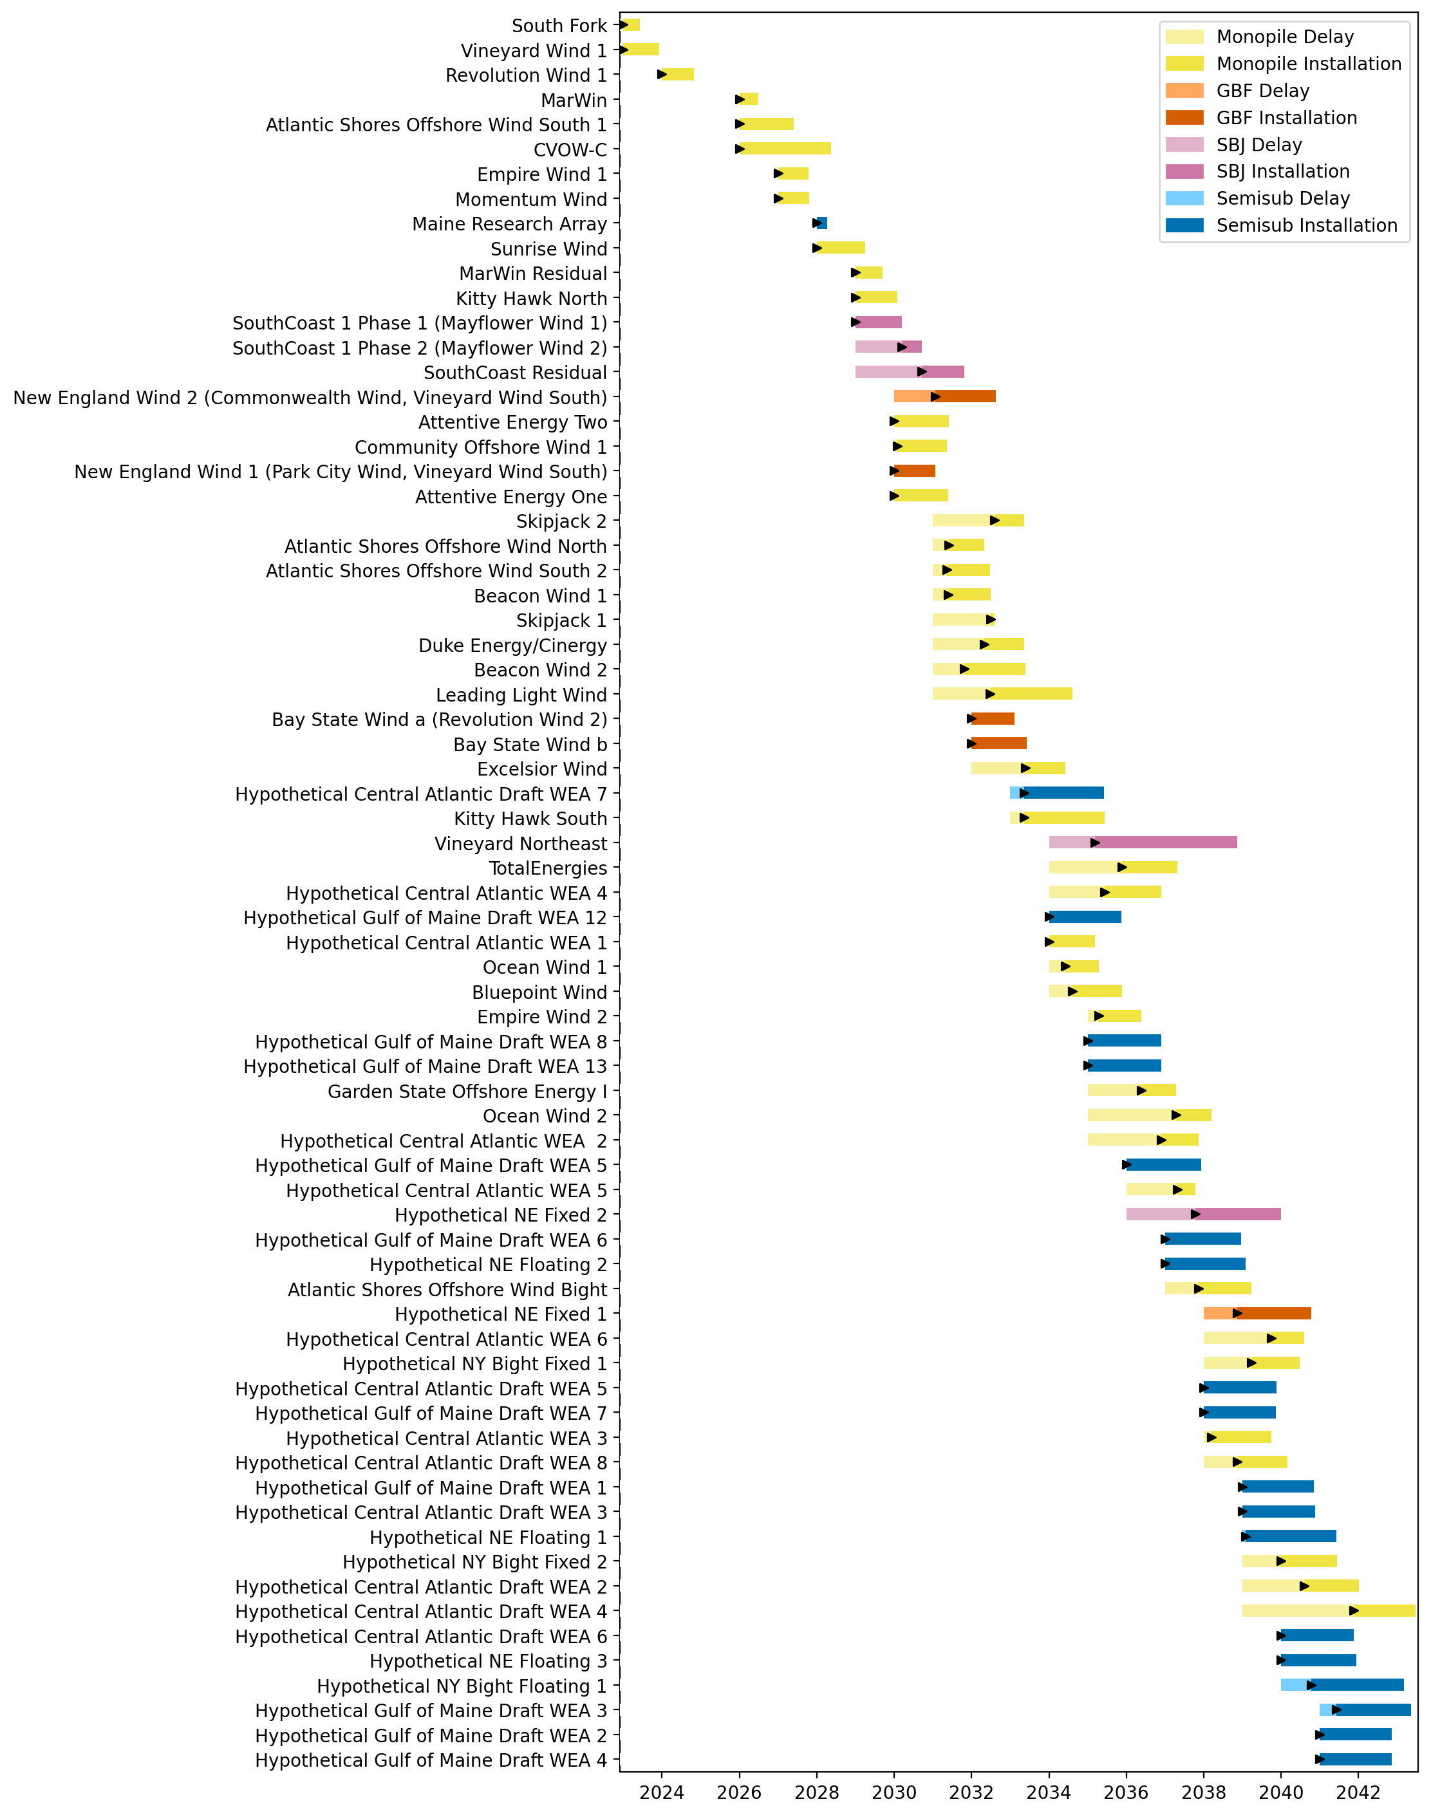
Sorted Full Gantt

Slide 25
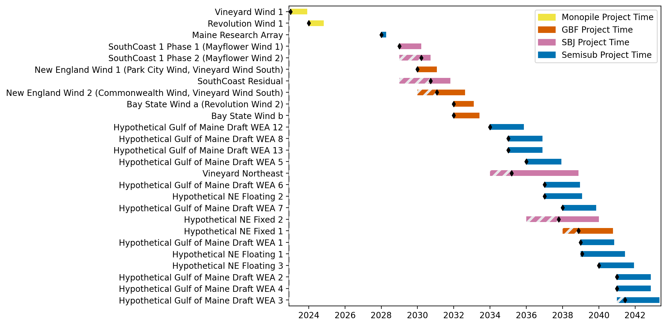
New England Gantt

Slide 26
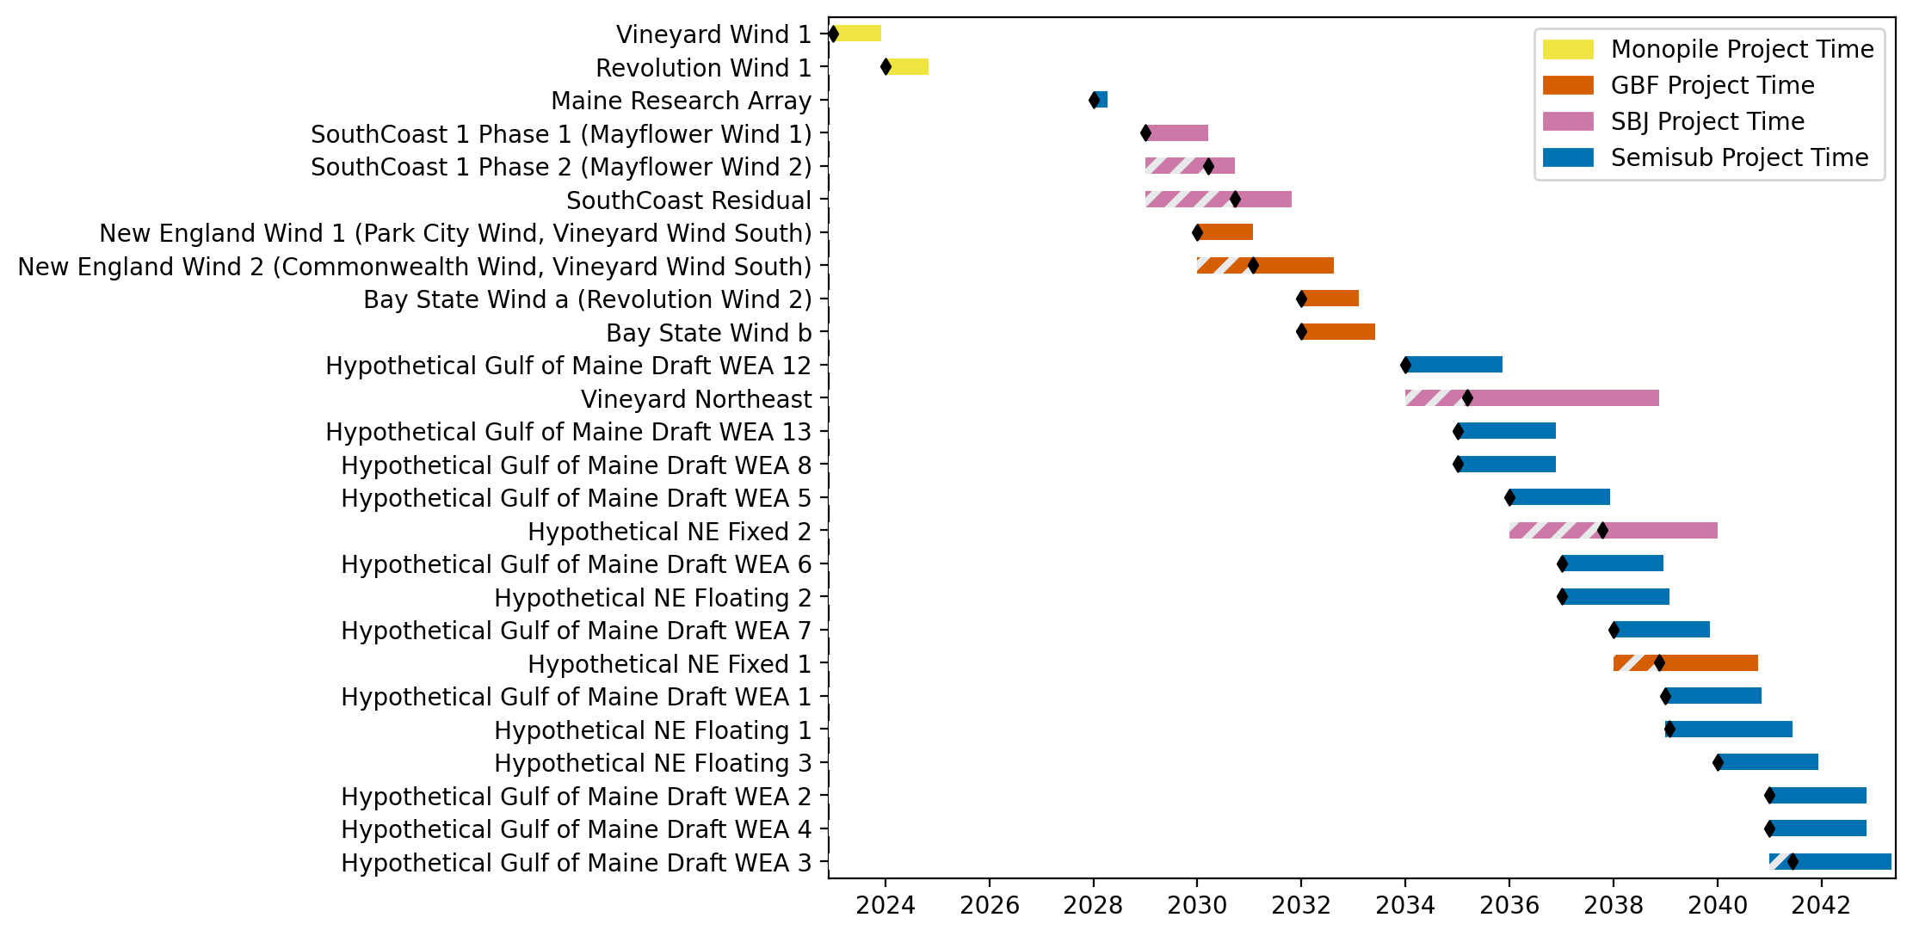
Sorted New England Gantt

Slide 27
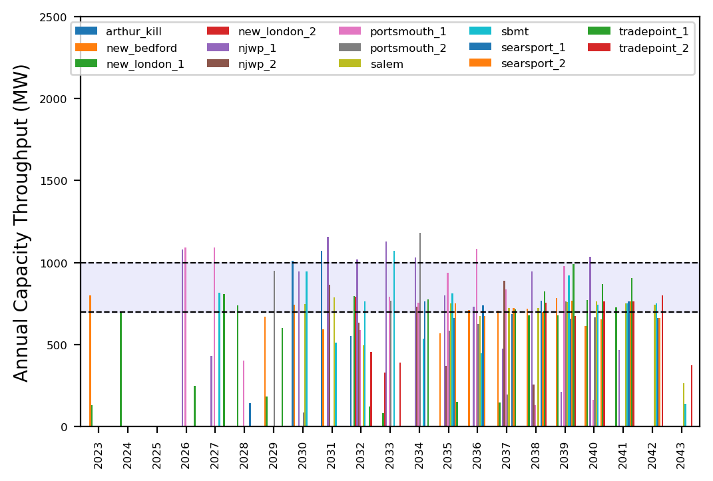
Port Throughput

Slide 28
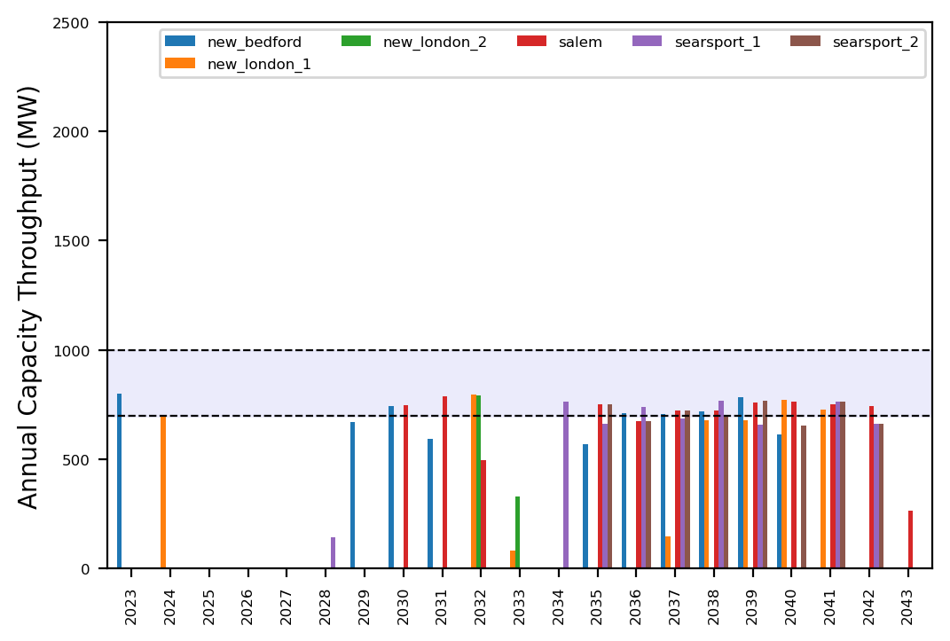
Port Throughput

Slide 29
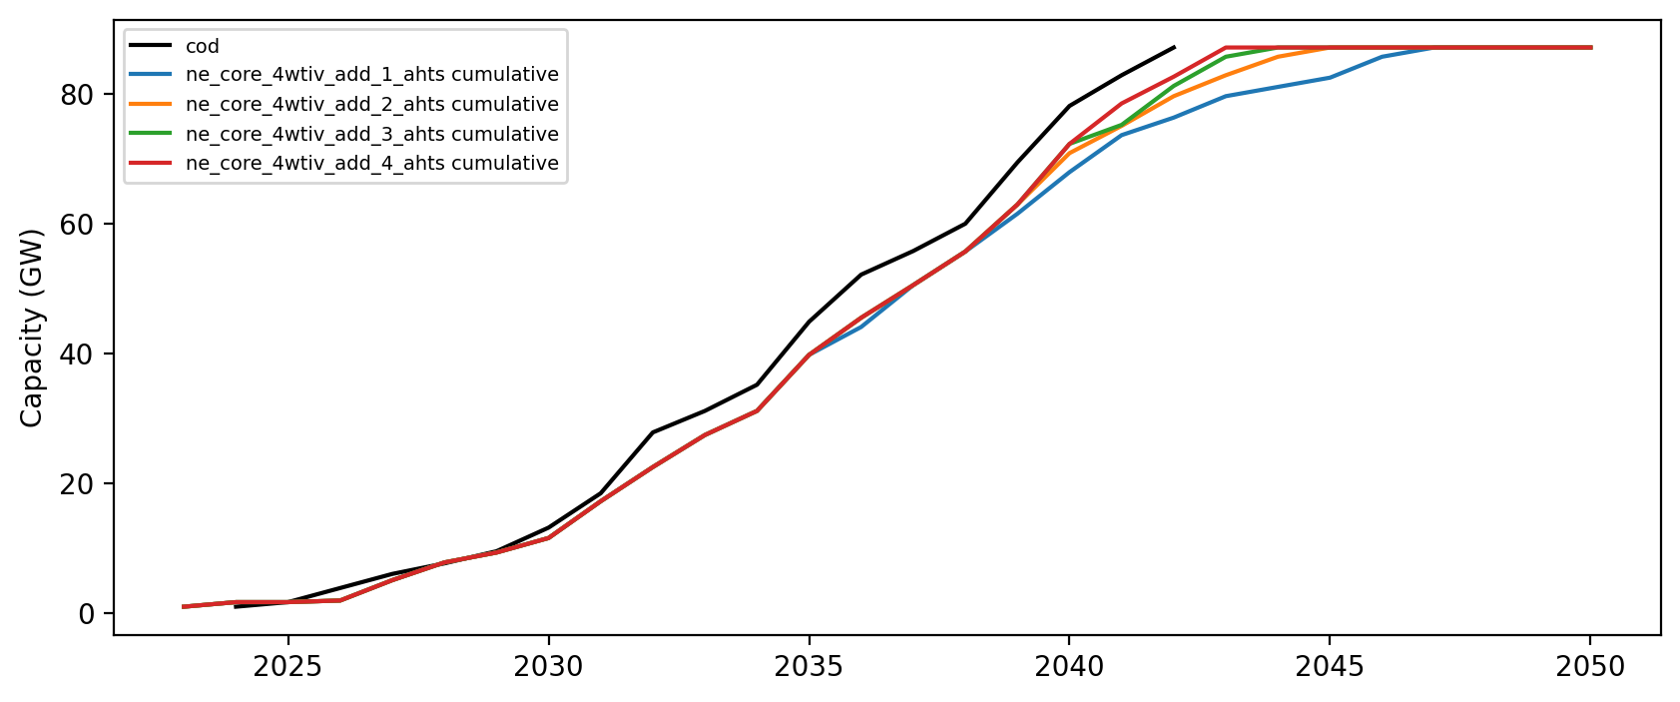
Installed Capacity

